Slide 1
BirdChat
Bringing people together

Slide 2
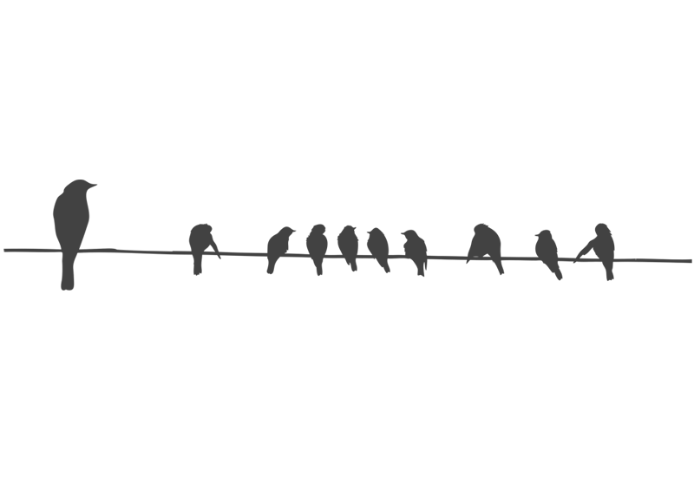
Vision
Promote informal conversations between the participants of a conference in any place at any time with the help of a mobile app.

Slide 3
Personal profile

Slide 4
Preview chats and it’s members before joining to see if it sparks your interest

Slide 5
Does it interest you? Feel free to join in!

Slide 6
What now?
After all it’s set and done, it’s time to meet up, turn off your phones and simply…
chat!

